Slide 1

D r e a m
COMPANY
Group E

Slide 2
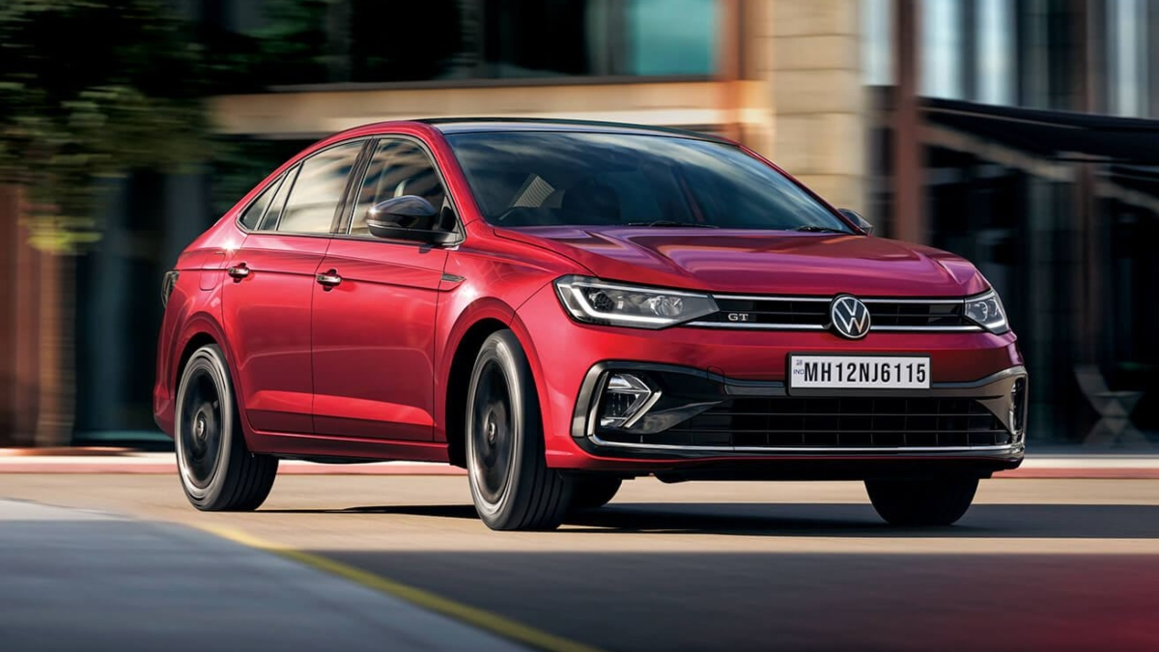

Company History | Yash
Founder’s History | Siddhant
Products & Innovations | Tarun
Brand Diversity | Yatra
Impactful Strategies
S.W.O.T Analysis | Garvit

Slide 3

Das Auto
Volkswagen

Slide 4

HISTORY

Slide 5
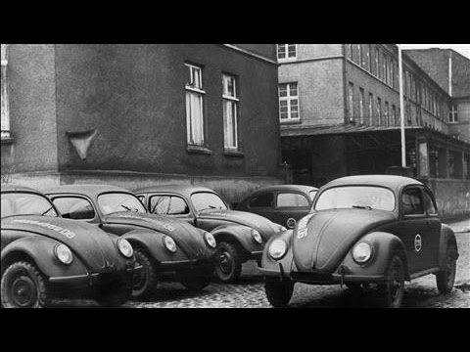
HISTORY
1 out of 50 people owned a car.
Adolf Hitler & Ferdinand Prosche envisioned affordable cars.
First Car - Beetle.
During WW2, Volkswagen started making army vehicles and ended up under British rule.

Slide 6
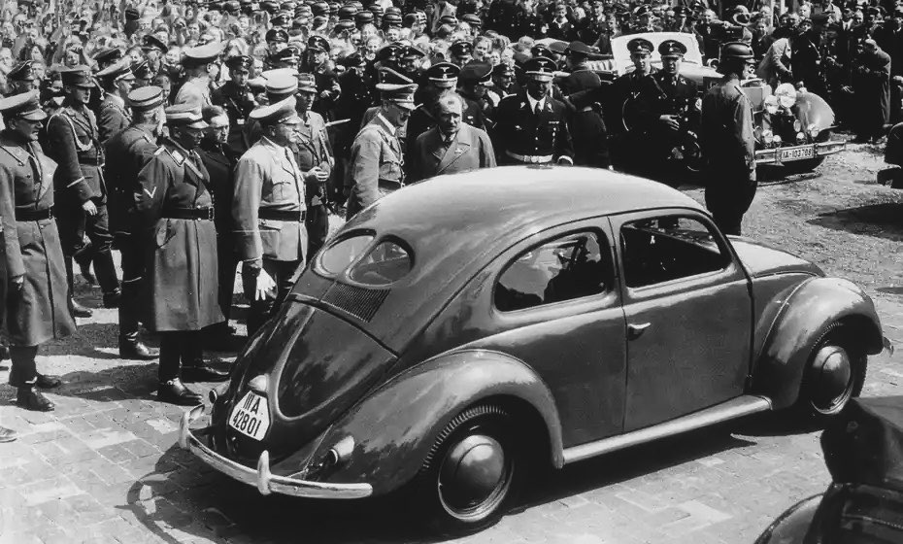
HISTORY
Volkswagen was offered to Ford [for FREE but they rejected]
VW started selling Beetle again.
In 1965 acquired Audi, in 1986 SEAT, in 1994 Skoda and so on…
Today VW has 340 subsidiary companies !! [Automotive and Financial Division]

Slide 7
The
FOUNDER

Slide 8
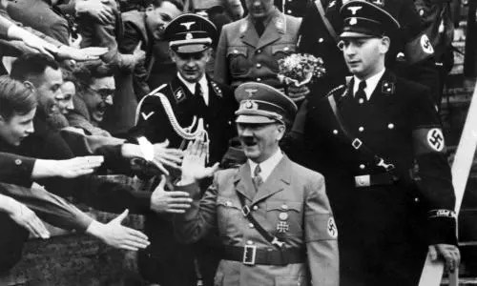
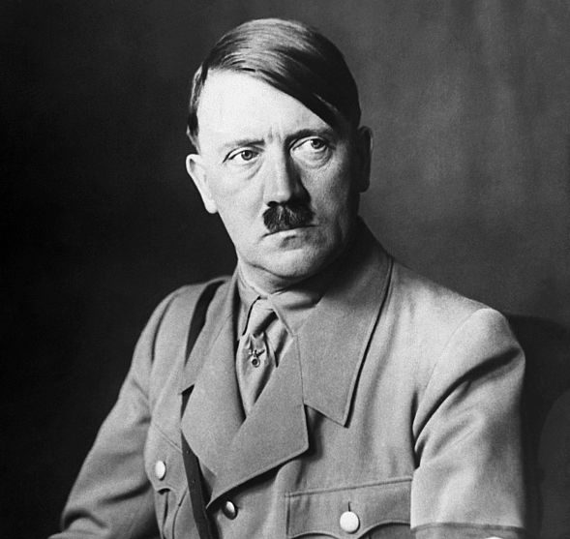

Founder
VW - originally operated by the German Labour Front (Deutsche Arbeitsfront), A Nazi organization.
Austrian born German politician.
Adolf Hitler
Dictator of Germany from 1933 till death.
German
Labour
Front

Slide 9
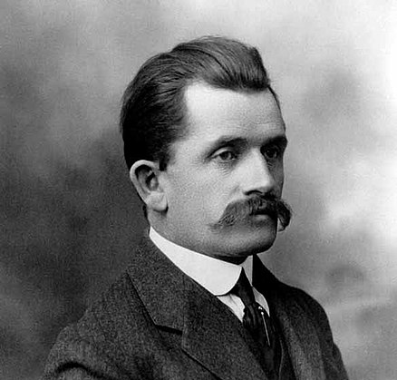


Founder
Austrian born automotive engineer and founder of the Porsche AG.
Best known for creating the first gasoline-electric hybrid vehicle, the Volkswagen Beetle.
Ferdinand Porsche
PORSCHE

Slide 10
Products &
INNOVATIONS

Slide 11

One of the first Aerodynamic Cars.
The Beetle
Inspired by nature.

Slide 12


One of the first brands to launch AFFORDABLE Cars.
Rated 9.5/10 in terms of SAFETY.

Slide 13

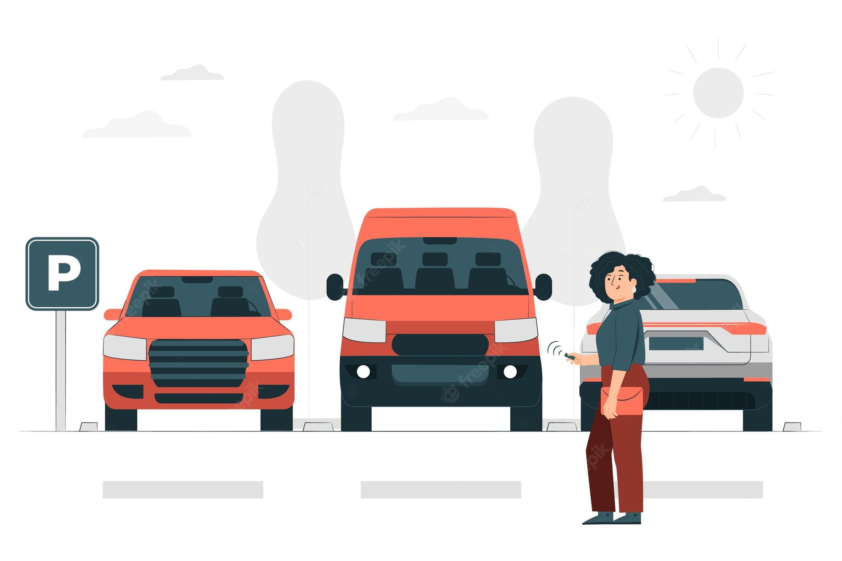
The Gesture Control feature.
Innovation in Automatic Steering while parking.

Slide 14
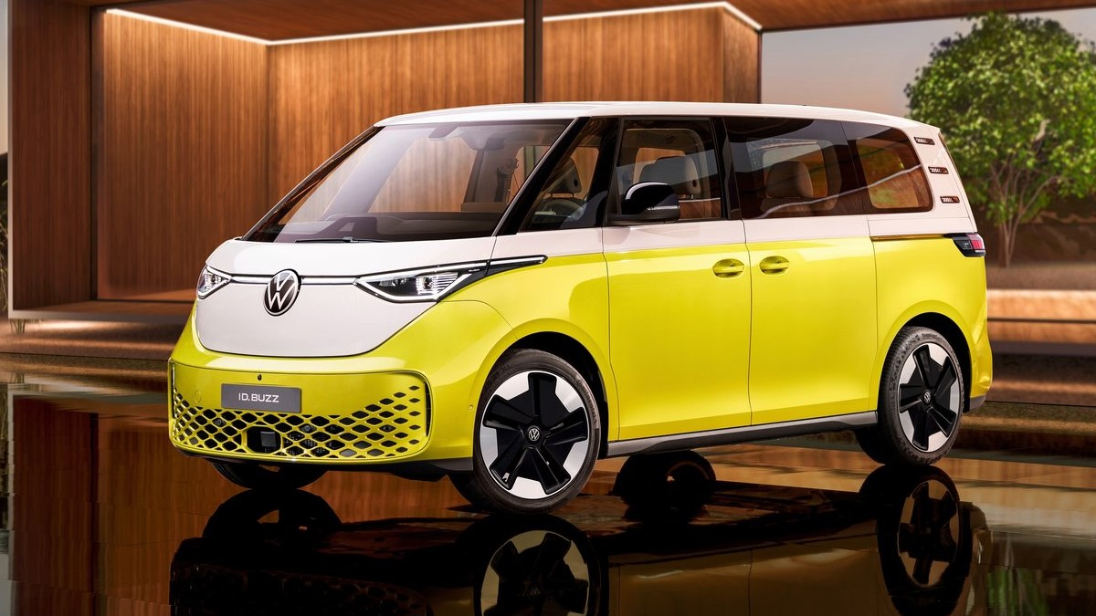
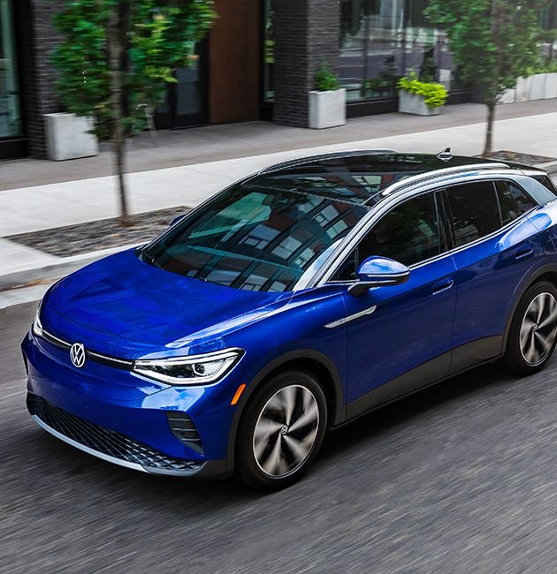
Model: Id.Buzz
EVs is the NEW ERA !!
Model: Id.4

Slide 15
Brand Diversity

Slide 16











Volkswagen

Slide 17
Impactful
Strategies

Slide 18

{
{
Volkswagen
People’s Car.

Slide 19
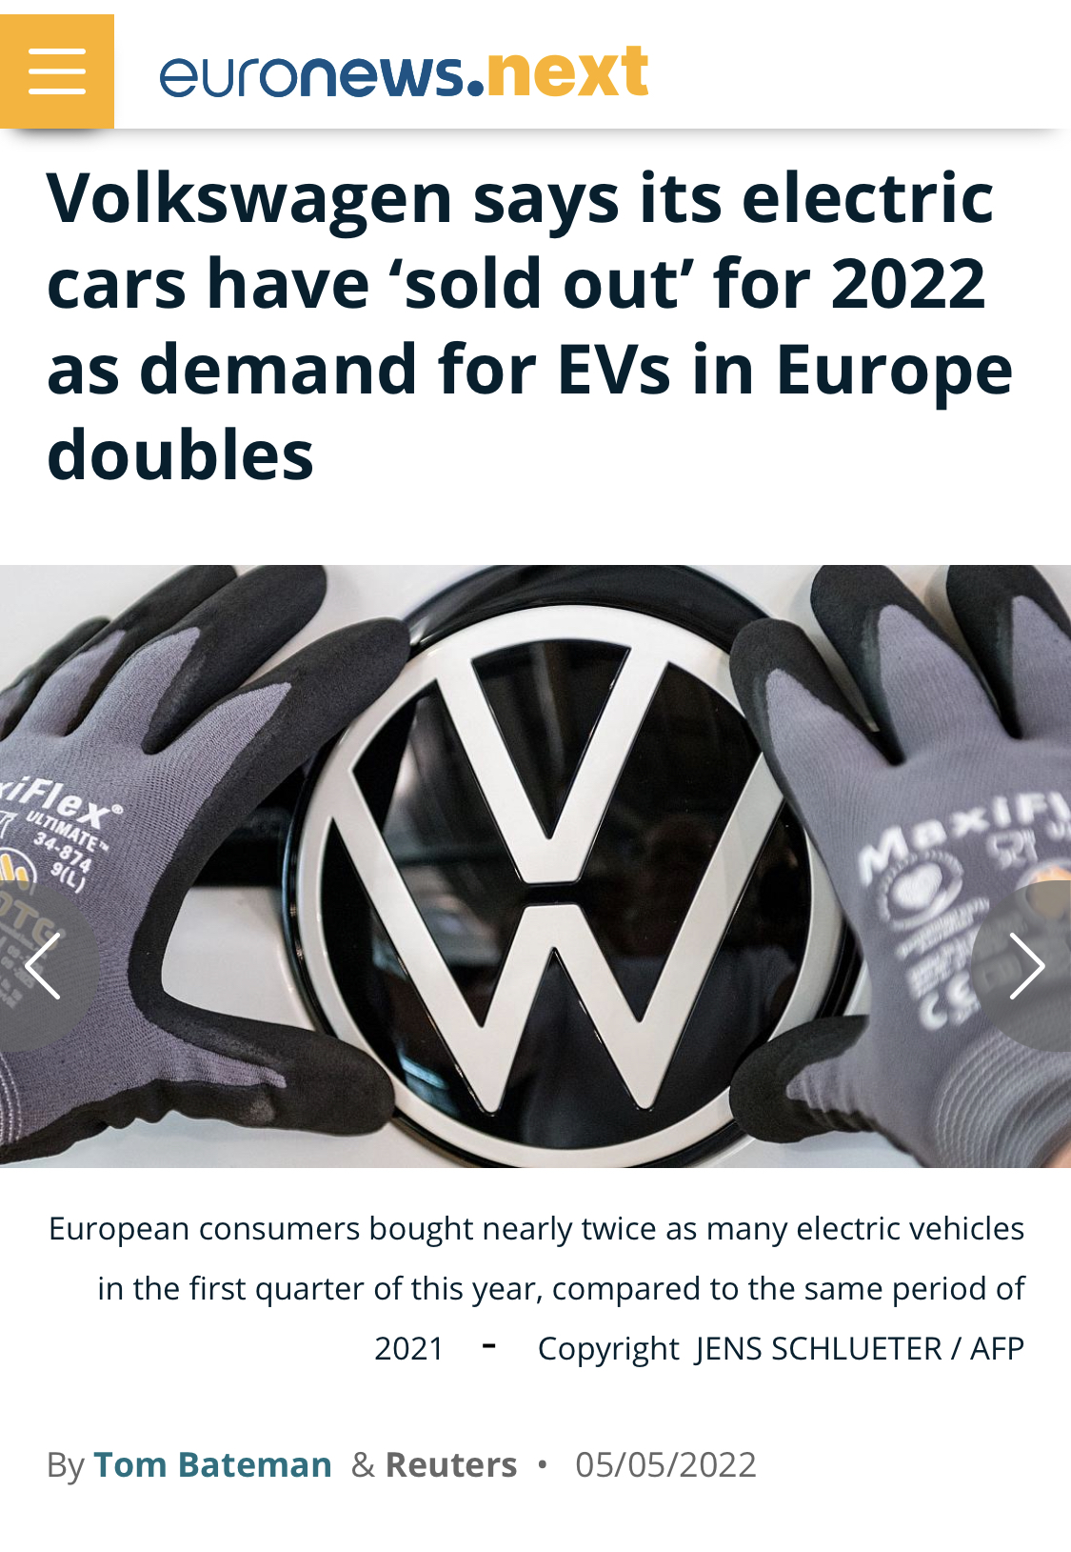
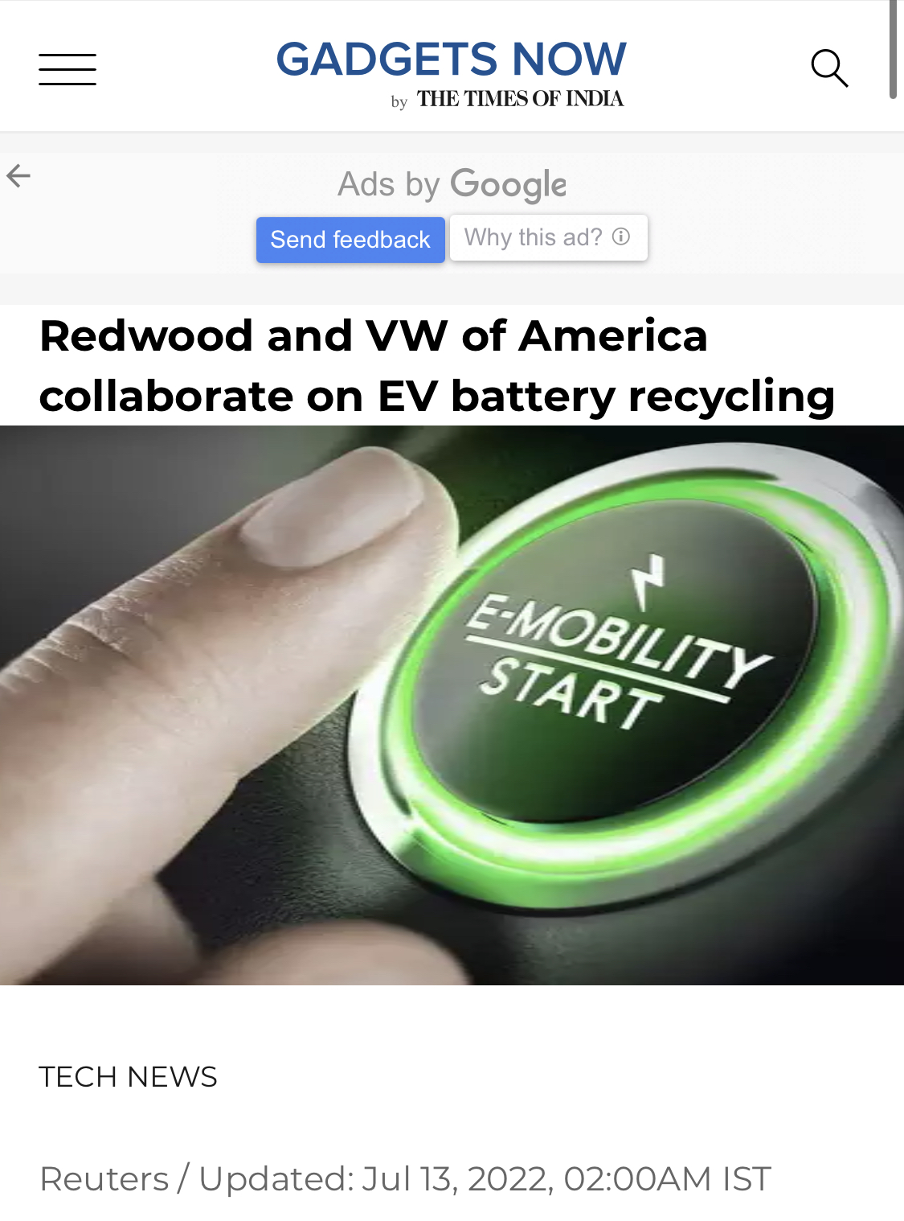

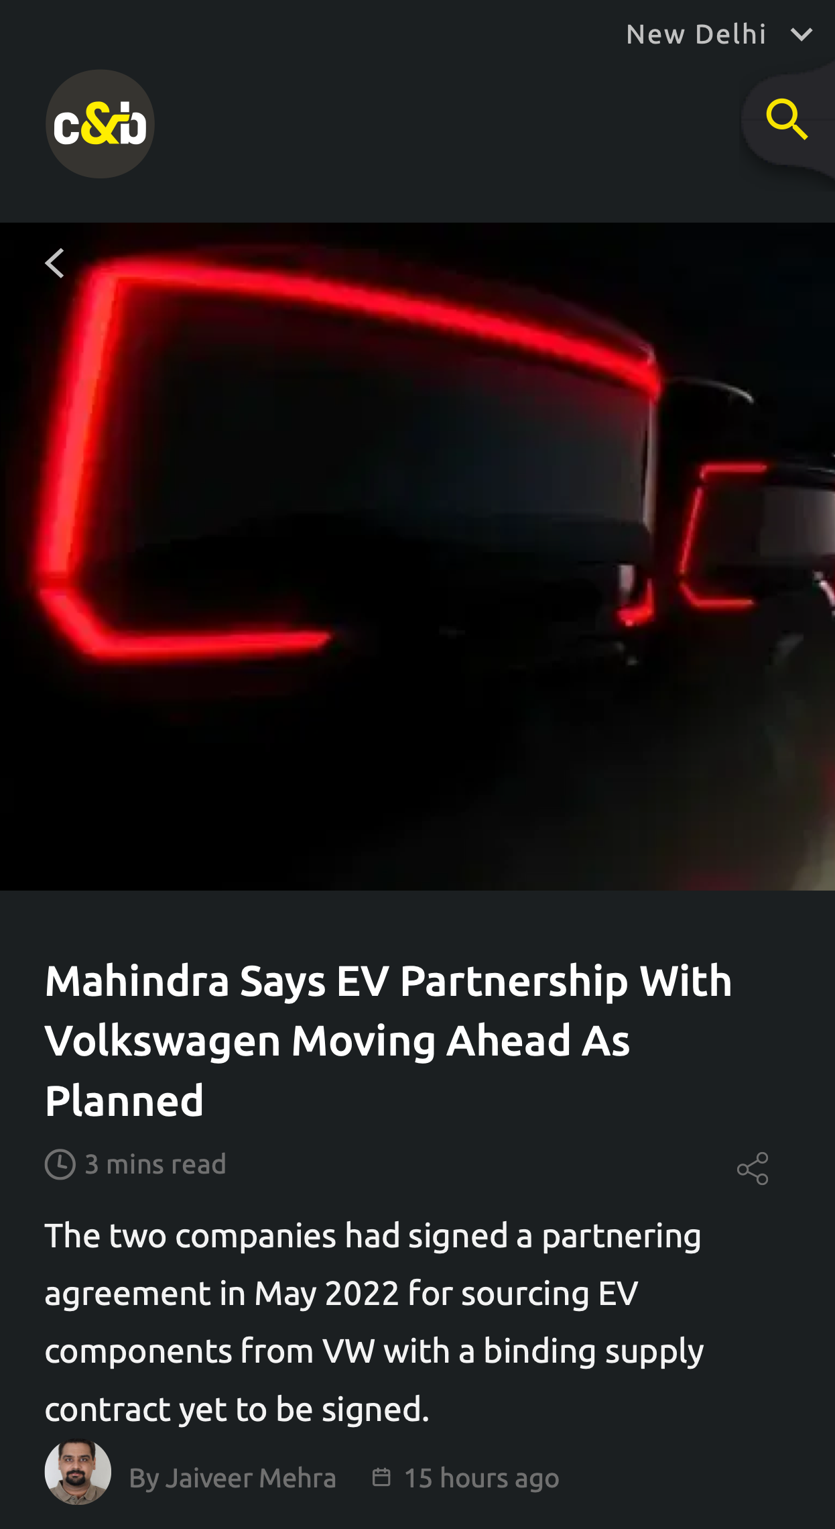


Slide 20
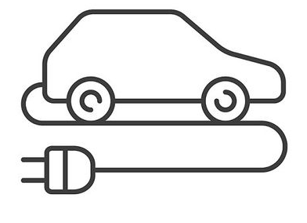
Impactful Strategies
Demand for EVs
Demand for EVs in Europe DOUBLES.
PRAISE for the milestone.
WAKE UP Call for meeting the demands

Slide 21

Impactful Strategies
Minimal Advertisement
Minimal advertisements in regions OUTSIDE of Europe
SATURATION in Europe
Target SHIFT needed

Slide 22
S.W.O.T
Analysis

Slide 23

Strengths
The Widest brand portfolio
Joint Ventures with local Chinese automakers
Diversification Strategy

Slide 24

Weaknes
Negative Publicity weakening the whole Volkswagen brand
Low Market Share in the US Markets

Slide 25

Threats
Intense Competition
Increasing government Regulations

Slide 26
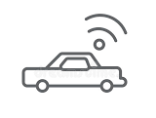
Opportunities
Demand for Autonomous Vehicles
Focus on significantly improving Sustainability Policies to remedy damaged brand reputation.

Slide 27
Any Questions ?
Thank You.

